Slide 1
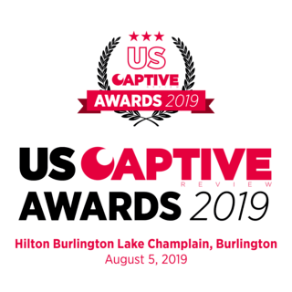

Slide 2
Domicile of the Year – Less than $5bn of Gross Written Premium
Shortlist
Alabama
Georgia
Missouri
North Carolina

Slide 3
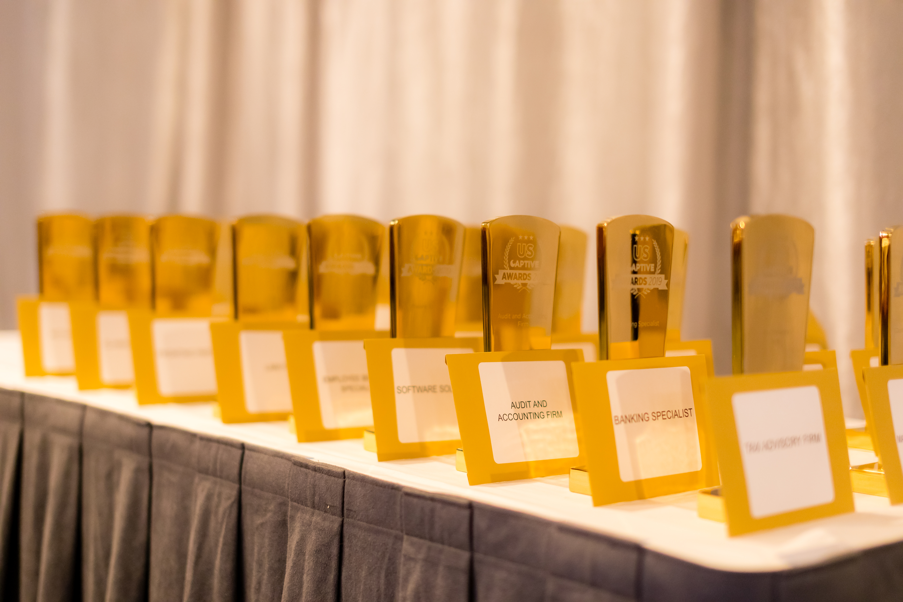
Domicile of the Year – Less than $5bn of Gross Written Premium

Slide 4
Domicile of the Year – Less than $5bn of Gross Written Premium
Winner
Alabama

Slide 5
Domicile of the Year – Less than $5bn of Gross Written Premium
Alabama Highlights
Placed in the Top 5 nationally each of the last three years in net captive formations

Slide 6
Domicile of the Year – Less than $5bn of Gross Written Premium
Alabama Highlights
Approved the first rider-share captive in the nation

Slide 7
Domicile of the Year – Less than $5bn of Gross Written Premium
Alabama Highlights
Through 2018, the 60-day provisional captive license has been utilized by 28 captives and protected cells

Slide 8
Domicile of the Year – Less than $5bn of Gross Written Premium
Alabama Highlights
The modernizing of the Alabama protected cell captive statute allowed for the creation of several new protected cell captives and several new captive risk retention groups

Slide 9
Sean Duke

Slide 10
Doug Sizemore, Former Tennessee Insurance Commissioner

Slide 11
George Dale, Former Mississippi Insurance Commissioner

Slide 12
Alabama: What’s next?
Clarify premium taxes/retailatory taxes for RRGs
Dormacy statute
Possibly credit for redomiciling to Alabama for existing captives
Internship program administered by the Association
Possible PR firm

Slide 13
Alabama: What’s next?
Three big announcements today
Alabama will take the lead nationally on these important issues

Slide 14
Alabama: What’s next?
#1 - For RRGs, a reinsurance structure that will allow for payment of claims in the event of RRG financial impairment

Slide 15
Alabama: What’s next?
To participate, RRGs must agree to:
capital requirements
pay an annual fee
periodic review
implement changes to fix issues raised in the periodic reviews

Slide 16
Alabama: What’s next?
We expect that participation in this RRG reinsurance program will ensure better overall corporate governance and achieve more financially sound RRGs
First in the nation structure

Slide 17
Alabama: What’s next?
#2 - For high risk coastal property insurance, an expansion of the Alabama Coastal Captive Act to include Washington and Escambia Counties with Mobile and Baldwin counties as continues where captives may write homeowners insurance.
Captive must write in Mobile and Baldwin counties to write in the other counties.
Possibly similar legislation in Mississippi that would allow the pooling of 10 counties in total between the two states with each regulator maintaining authority

Slide 18
Alabama: What’s next?
These changes allow for better risk distribution and open more opportunities in the reinsurance market
First in the nation structure

Slide 19
Alabama: What’s next?
#3 - Establishment of a new not-for-profit to allow for self-regulation of captive industry service providers.
Expected to quickly become a national certification program.
Desperately needed in our industry

Slide 20
Alabama: What’s next?
These changes allow the industry to self-regulate
First in the nation structure

